Slide 1
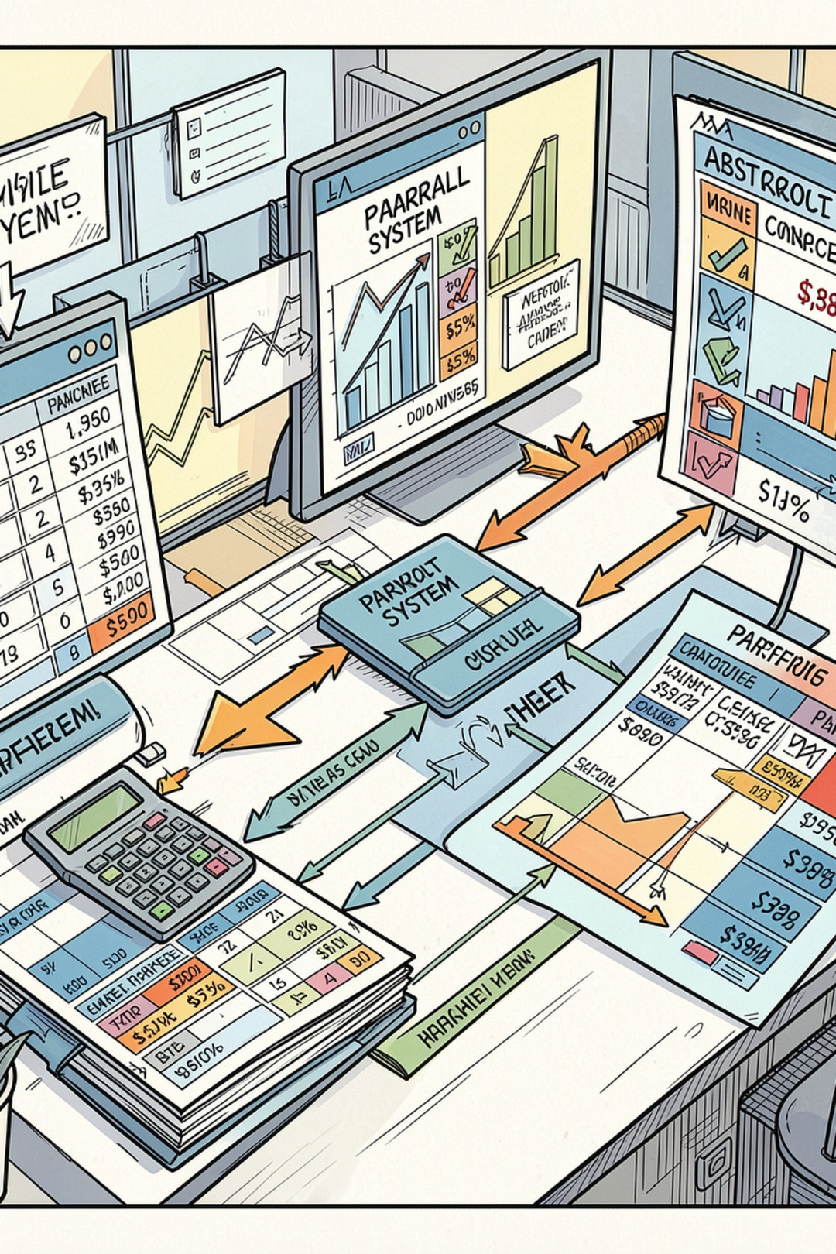
Employee Payroll and Statutory Deduction Management System
Muneeb Siddiqui · 25WU0102265
SUBJECT : DBMS
Notes:
1

Slide 2
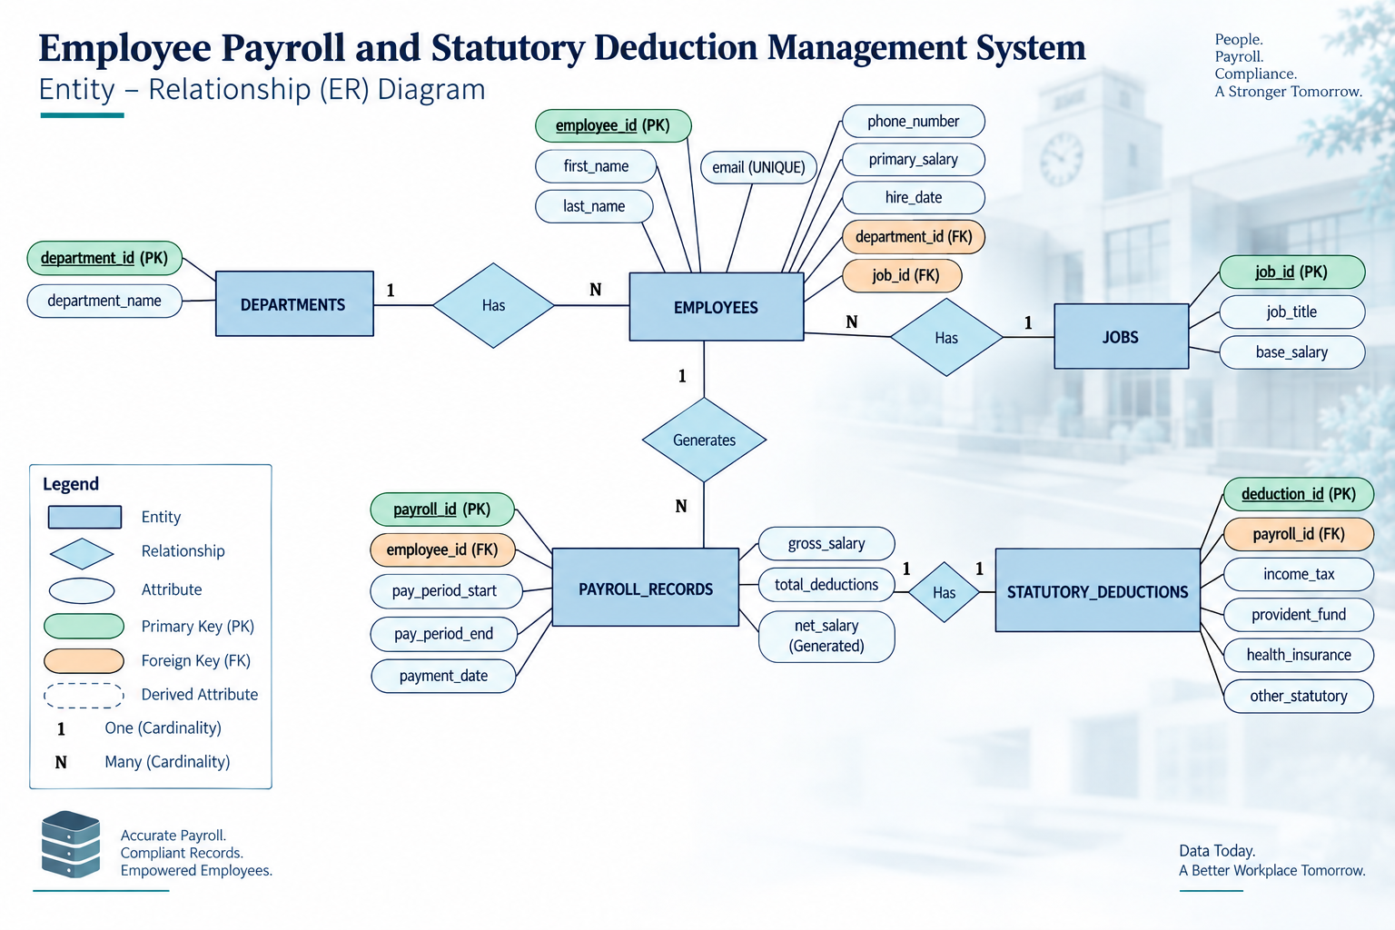
Notes:
2

Slide 3
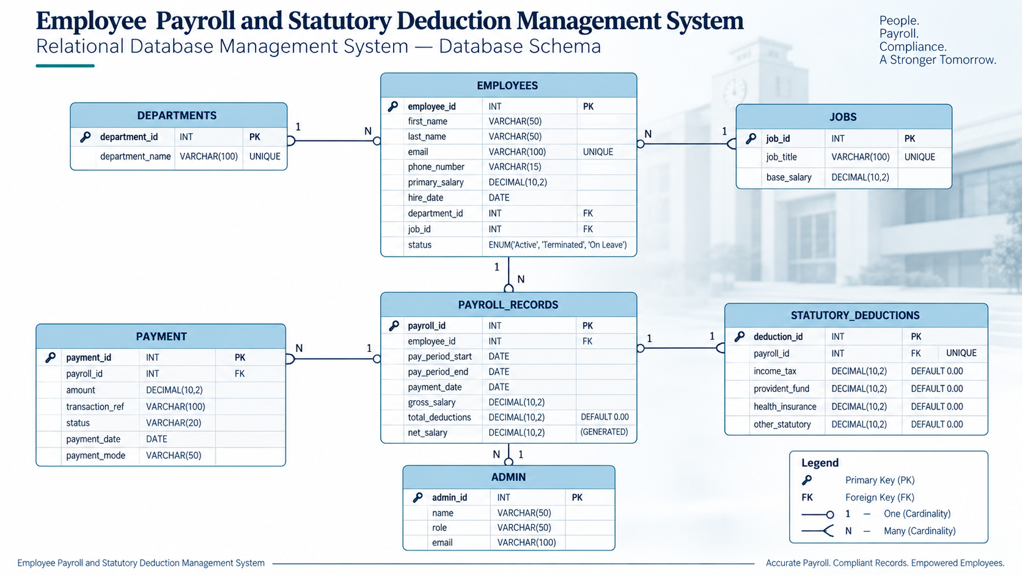
Notes:
3

Slide 4
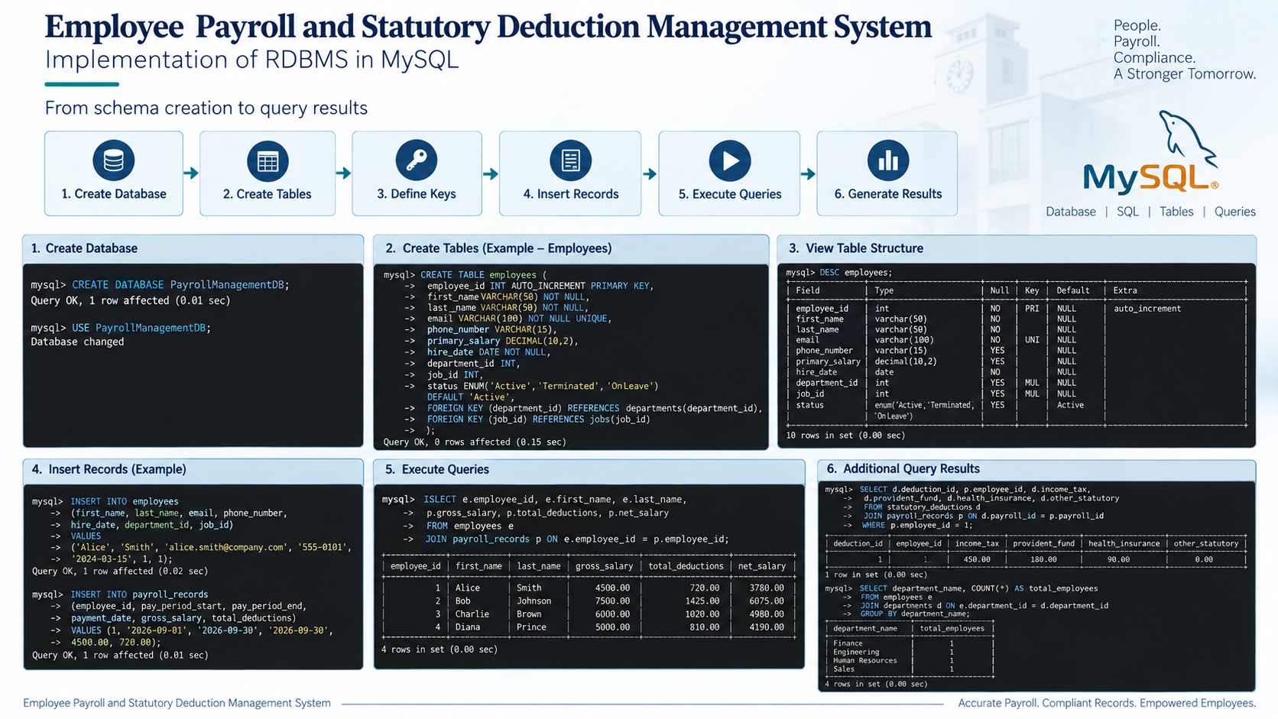
Notes:
4

